Slide 2
The humble PUT statement

Slide 3
Before we start the main talk …

Slide 4
Automatic diagrams from your SAS code

Slide 5
The process
Add macros to your code & run it
Run analysis program
Make diagram

Slide 6
The process – run your code
%let _eandebug=scaproc ;
%eanbegin(Sample 1)
data x ;
set sashelp.class ;
run ;
data y ;
set sashelp.class ;
run ;
proc summary data=x ;
class sex ;
var height ;
output out=x2 mean= ;
run ;

Slide 7
The process – file generated by PROC SCAPROC
/* JOBSPLIT: DATASET INPUT SEQ WORK.A.DATA */
/* JOBSPLIT: DATASET OUTPUT SEQ WORK.NEW1.DATA */
/* JOBSPLIT: SYMBOL GET SYSSUMTRACE */
/* JOBSPLIT: ELAPSED 46 */
/* JOBSPLIT: PROCNAME SUMMARY */
/* JOBSPLIT: STEP SOURCE FOLLOWS */
proc summary data=a;
var x;
output out=new1 mean=mx;
run;

Slide 8
The process – run analysis
digraph test {
graph [label="\n\nTest title\n30AUG16:10:40:50"]
node [shape=box color=lightblue style=filled]
"PRINT"[shape=ellipse color=lightgreen]
”SASHELP.CLASS"->"WORK.X" [label=" datastep (0.506)" color=red penwidth=7 style=solid];
”SASHELP.CLASS"->"WORK.Y" [label=" datastep (0.267)" color=red penwidth=4 style=solid];

Slide 9
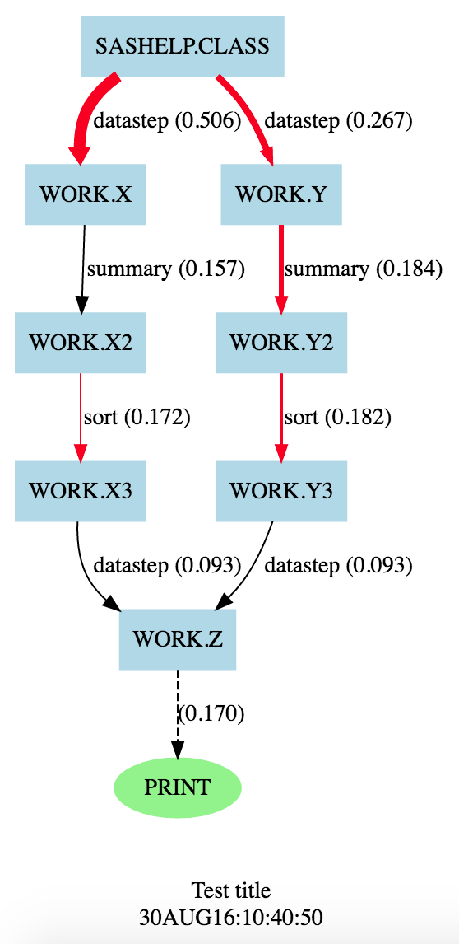
The process – make diagram

Slide 10
The humble PUT statement

Slide 11
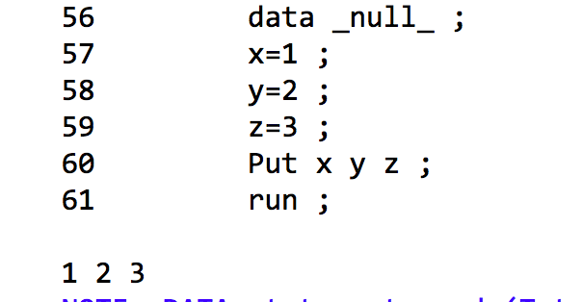
Writes values out separated by a space
Just put a space between variables.

Slide 12
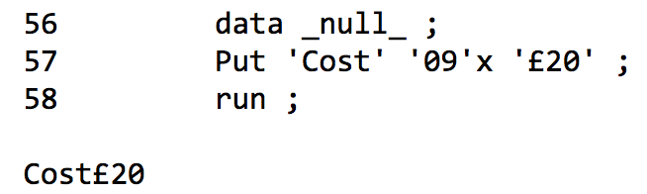
Write values followed by a tab, useful for making tab-separated files
‘09’x is a tab character expressed as a hexadecimal literal. 09 is the ASCII code for tab.

Slide 13
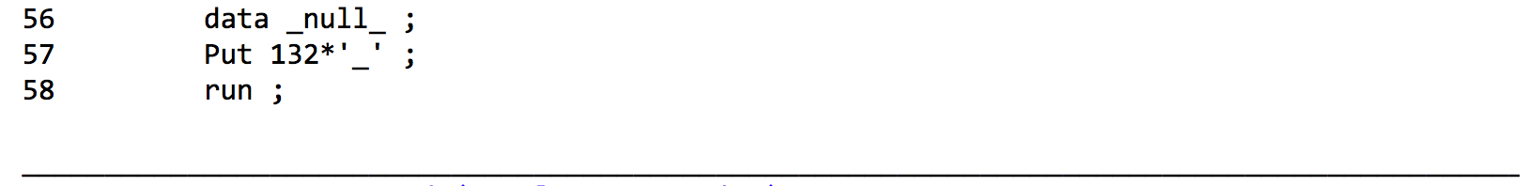
Write 132 underscores
Number followed by a star, then the character to repeat.

Slide 14
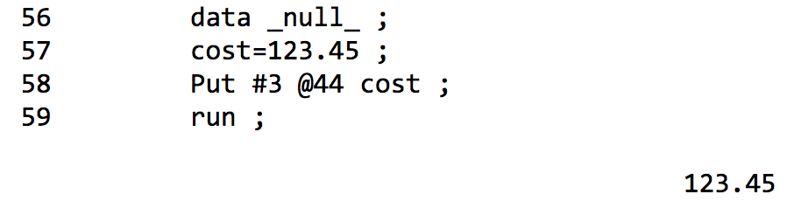
Write a value starting at a specific line and column
# specifies the line number, @ specifies the column.

Slide 15
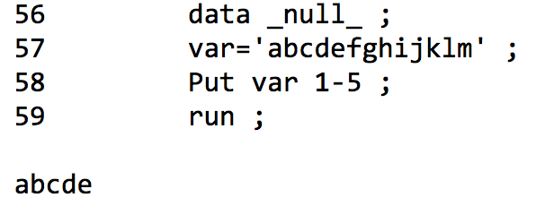
Write value into specific columns, only writing parts of value that fit
Column range comes after variable it applies to, and is separated by a dash.

Slide 16
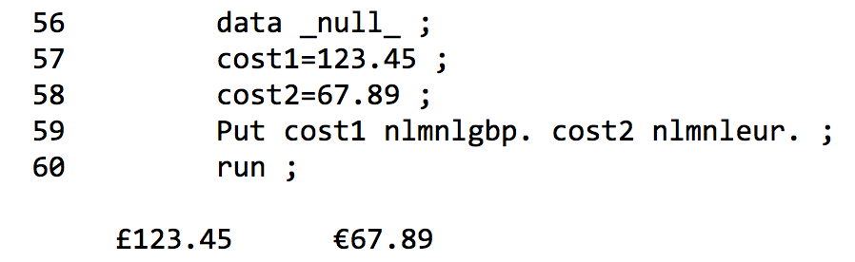
Write a formatted value, in GBP or EUR
NL formats are the National Language formats provided with SAS.

Slide 17
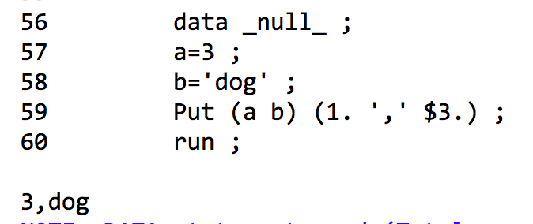
Write a list of variables using a list of formats, with separators
List of variables in brackets, followed by list of formats and other characters in brackets.
First variable goes with first format, and so on.

Slide 18
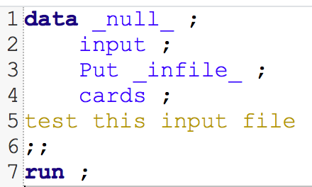
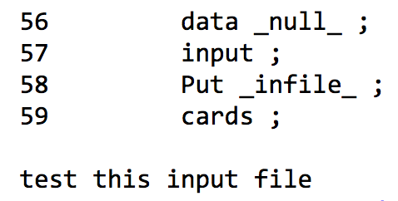
Write current input buffer, as read by last input statement
_infile_ represents the line last read in by input statement.

Slide 19
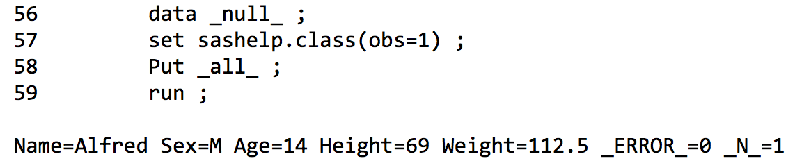
Write the values of all variables, including _error_ & _n_
Writes all variables as variable-name=variable-value. Includes all variables in PDV.

Slide 20
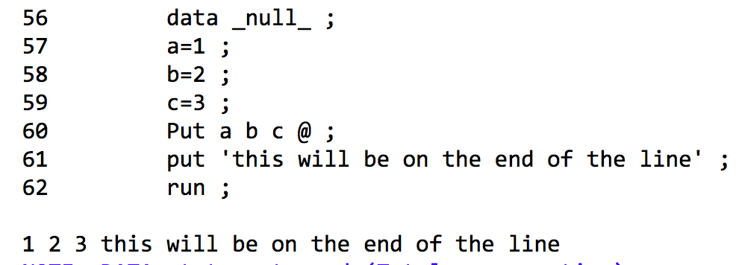
Write values to a line, and then some more to the same line
@ on the end of a put statement keeps line open to write more to it.

Slide 21
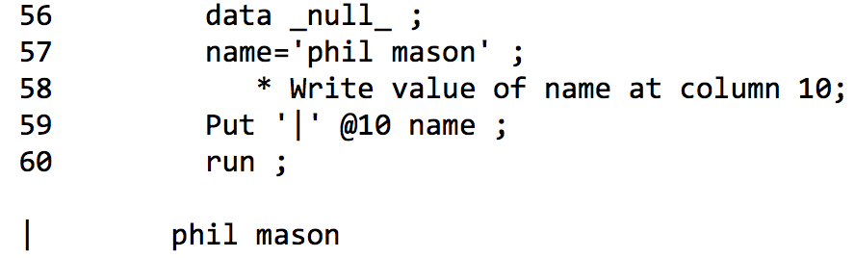
Write value at a specific position on line
@ used to specify column, and uses the number specified.

Slide 22
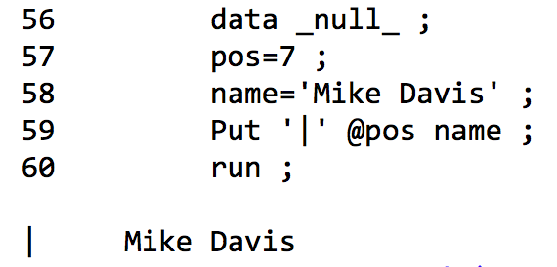
Write to a column specified by a variable
@ can get its value from a variable.

Slide 23
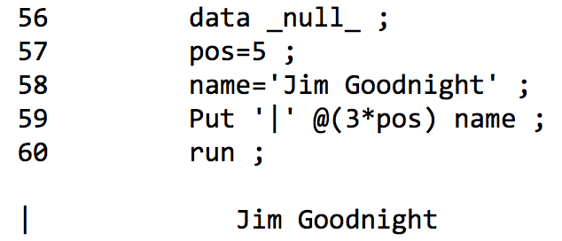
Write value at column specified as a variable times a factor
@ can do a simple calculation on a variable and then use that value.

Slide 24
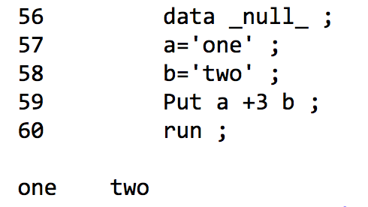
Write value with a number of spaces between them
+ number says to skip that many spaces on the line being written.

Slide 25
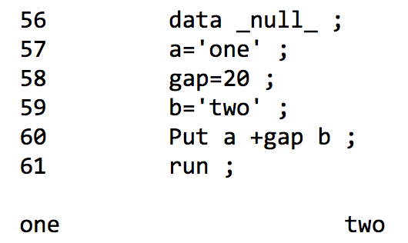
Write values with a number of spaces between them specified by variable
+ can get its value from a variable

Slide 26
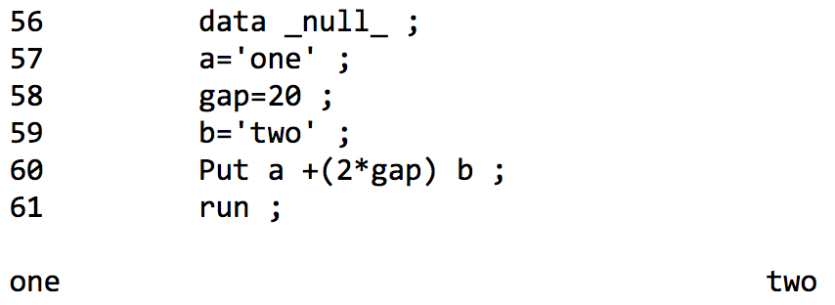
Write values separated by spaces determined by an expression
+ can do a simple calculation to work out how many columns to skip.

Slide 27
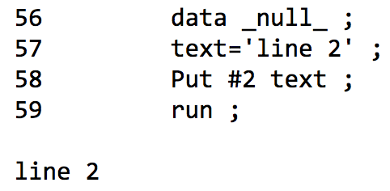
Write a value at a specified line
# says to skip down a number of lines.

Slide 28
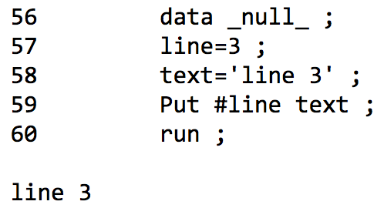
Write value to a line specified in a variable
# can get the lines to skip from a variable.

Slide 29
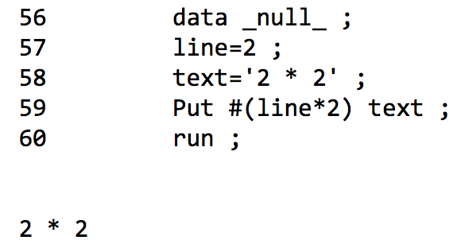
Write value to a line specified by an expression
# can get the lines to skip from a simple calculation.

Slide 30
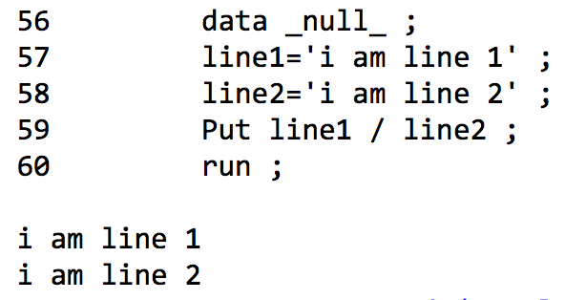
Write variables and go to a new line
You can go to a new line using a / character.

Slide 31
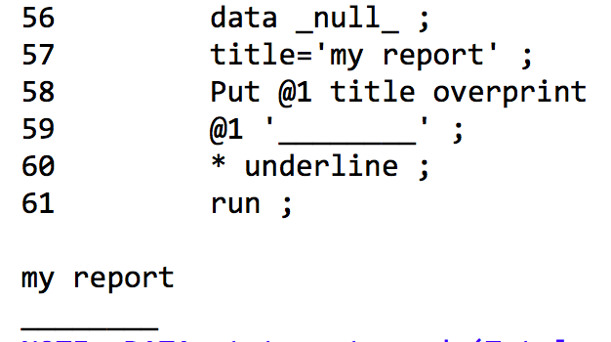
Overprint will print over existing text in a file (no effect on screen)
Overprint was made in the days of dot-matrix printing to do underlining.
Doesn’t work well today.

Slide 32
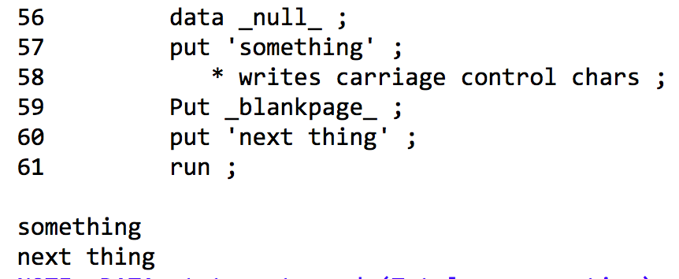
Print an entirely blank page
In printed output_blankpage_ will produce an entirely blank page.

Slide 33
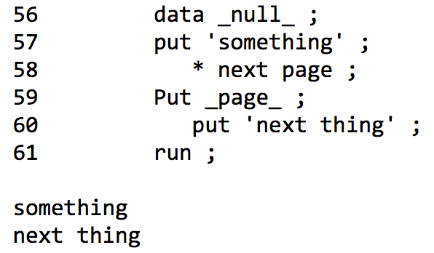
Go to a new page
When printing _page_ will go to the start of the next page.

Slide 34
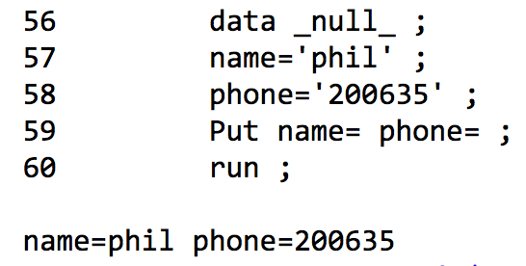
Write values prefixed by variable names
using an = sign on a variable will write the variable-name=variable-value

Slide 35
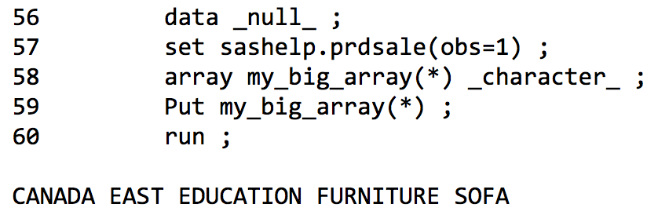
Write values of an array
using an array name with a * as index will write values for each element of array.

Slide 36
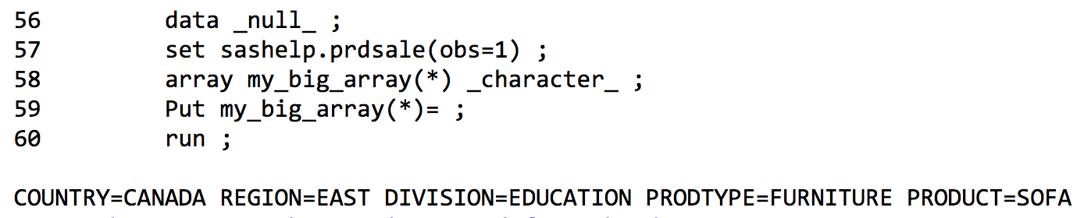
Write values of an array, with variable names
putting an = on the end of array specification will write variable names too.

Slide 37
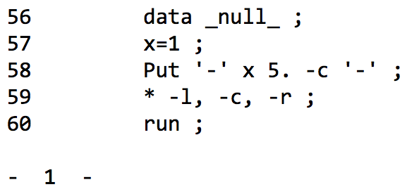
Write a variable using a format & justify value within field width
putting a –c after a format will means it is written centered in the width of field.
-c centers, -l left justifies, -r right justifies.

Slide 38
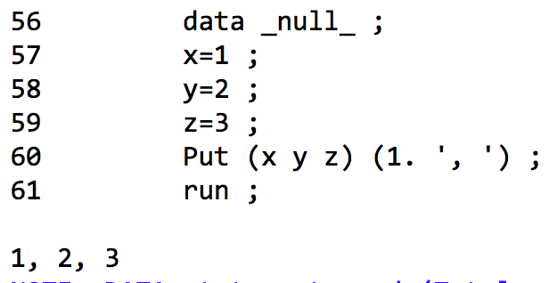
Write formatted values separated by some text
each variable in first brackets as matched with format in second bracket, and string.
equivalent to … put x 1. ', ' y 1. ', ' z 1. ', ' ;

Slide 39
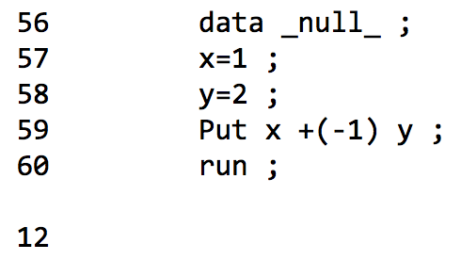
Write character values with no separating space
after writing a variable pointer is moved on a character to leave a space.
+(-1) moves it backward by one space which removes the space that was added.

Slide 40
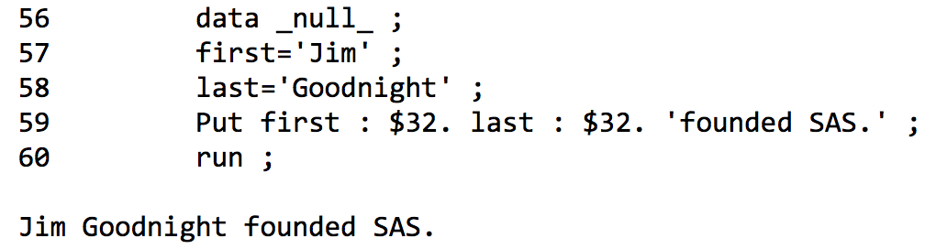
Writing values with a format, but removing surrounding spaces
: is used to remove spaces around formatted text before writing

Slide 41
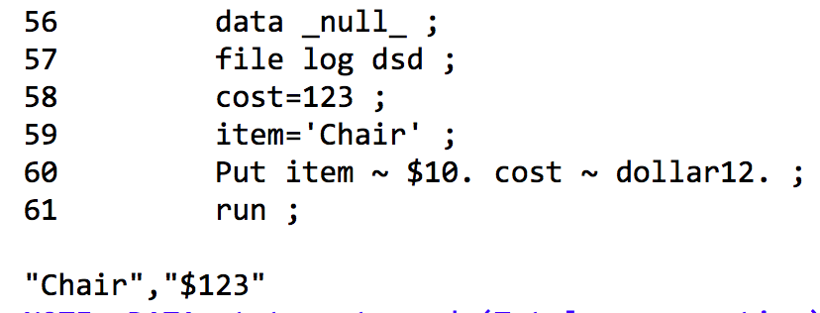
Write value to a file using stripped formatted quoted value
like : the ~ removes spaces, but also puts quotes around the value before writing.

Slide 42
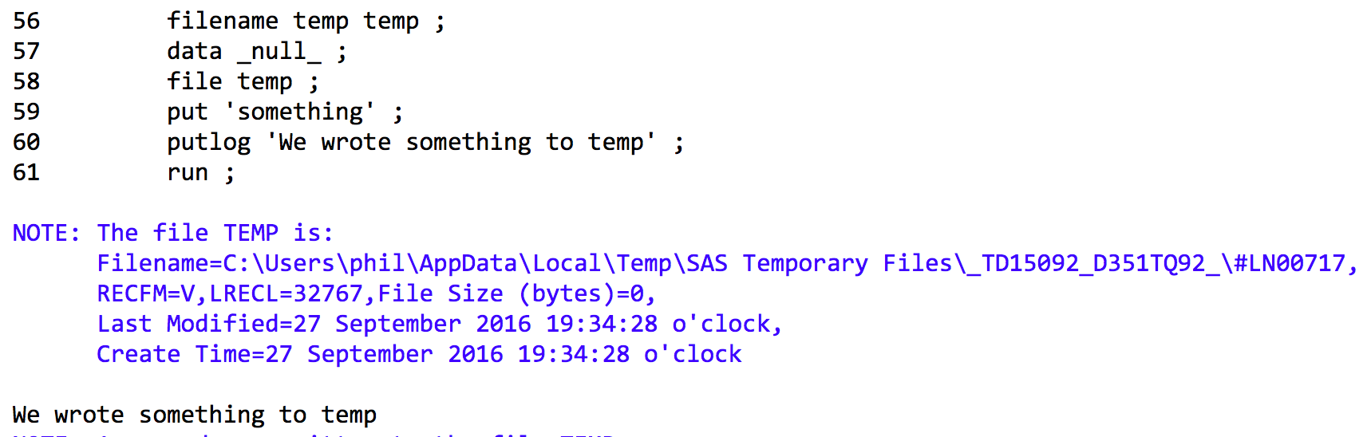
Use PUTLOG to write to log when writing to another location
put will write to the last fileref specified, or log if none was specified.
putlog will always write to log.

Slide 43
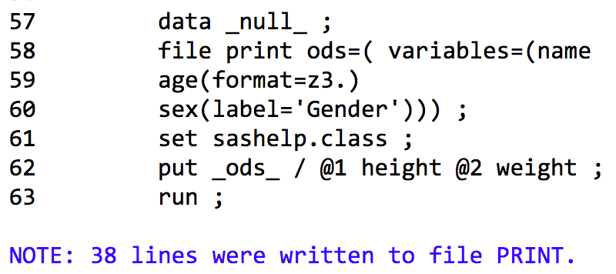
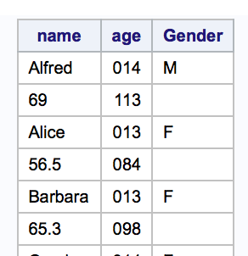
Write to ODS destinations
we can define variables and some attributes with FILE for ODS destination.
_ods_ will write all define variables out, but we can write others out too.

Slide 44
Any Questions?

Slide 45
e-mail me … phil@woodstreet.org.uk

